Slide 1
MSc Software Development
Programming
Iteration statements - loops

Slide 2
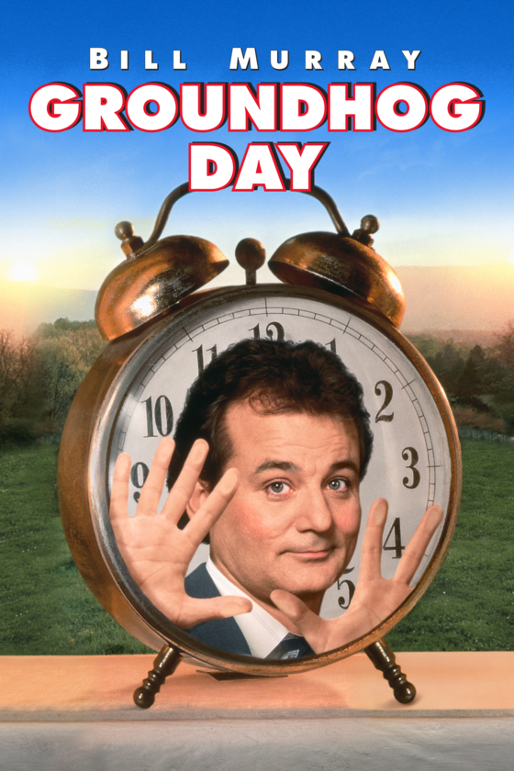
Loops
Sometimes it is necessary for the program to execute a statement(s) several times, Java loops enable the execution of a block of commands a number of times until a condition is met.
There are three main types of loops in Java:
for : The for loop is used for iterating over a sequence of values. It consists of three parts: initialisation, condition, and iteration statement. The loop runs as long as the condition is true.
while : The while loop repeatedly executes a block of code as long as a specified condition remains true. The condition is checked before each iteration.
do-while : The do-while loop is similar to the while loop, but the condition is checked after each iteration. This ensures that the loop's code block is executed at least once.

Slide 3


Loops – all you need
A repetition (or looping) statement allows you to specify that a program should repeat an action while some condition remains true.
While there are more items on my shopping list
Purchase the next item and cross it off my list
The condition “there are more items on my shopping list” may be true or false.
If true the loop body executes and the condition is then tested again.
When false the loop terminates.
Essentials of Counter-Controlled Repetition loop
1. a control variable (or loop counter)
2. the initial value of the control variable
3. the increment (or decrement) by which the control variable is modified each time through the loop (also known as each iteration of the loop)
4. the loop-continuation condition that determines if looping should continue.

Slide 4
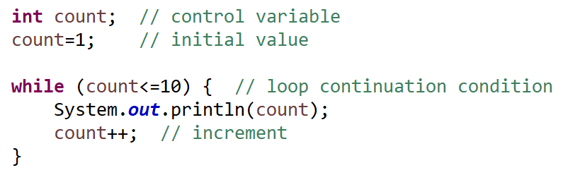
while loop
while (expression) {
statement(s) // loop body
}
1
2
3
4
5
6
7
8
9
10

Slide 5
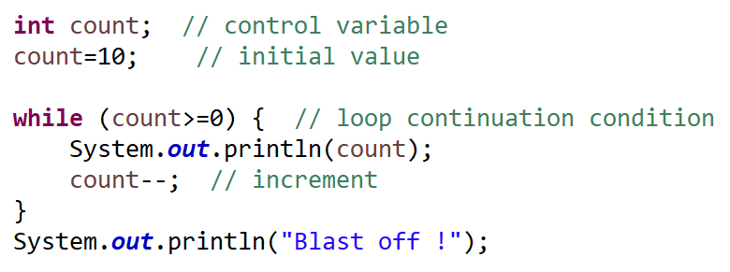

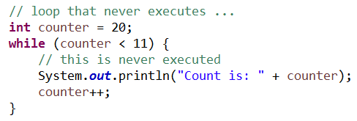
while loop
10
9
8
7
6
5
4
3
2
1
0
Blast off !
Note the while loop may never execute. If the initial condition is false then the body of the loop will not execute.

Slide 6
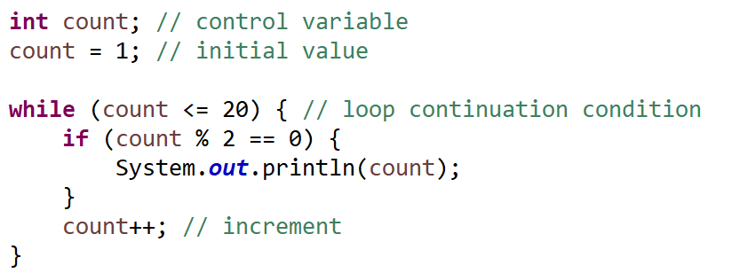

while loop
2
4
6
8
10
12
14
16
18
20
Even numbers between 2 and 20
While loop exercise
Create an application that randomly generates a number between 1 and 10 (inclusive). It then continually prompts the user to guess the number until they get it right.
Hints : you’ll need the Scanner and the Random class. Think about the Condition that will need to be satisfied to enter / leave the loop. Eg while the user’s guess is not the same as the random number then prompt again
Notes:
import java.util.Random;
import java.util.Scanner;
/**
* Class for Guessing game app
* @author amcgowan
*/
public class GuesserDemo {
/**
* Generates a random number between 1-10. User tries to guess it.
* @param args
*/
public static void main(String[] args) {
Scanner scanner = new Scanner(System.in);
Random random = new Random();
int randomNumber, userGuess;
// default value
userGuess = -1;
// get the random number
randomNumber = random.nextInt(10);
randomNumber++;
while (randomNumber != userGuess) {
// get user input
System.out.println("Enter your guess (1-10) ?");
userGuess = scanner.nextInt();
}
System.out.println("Well done.. you got it !");
scanner.close();

Slide 7
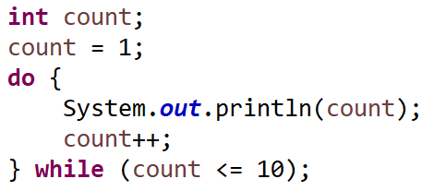
do .. while loop
Similar to the while statement but …
The while statement, tests the loop-continuation condition at the beginning of the loop, before executing the loop’s body; if the condition is false, the body never executes.
The do…while statement tests the loop-continuation condition after executing the loop’s body; therefore, the body always executes at least once.
When a do…while statement terminates, execution continues with the next statement in sequence.
do {
statement(s)
} while ( condition );
1
2
3
4
5
6
7
8
9
10

Slide 8
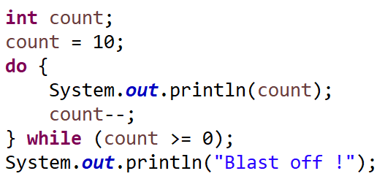

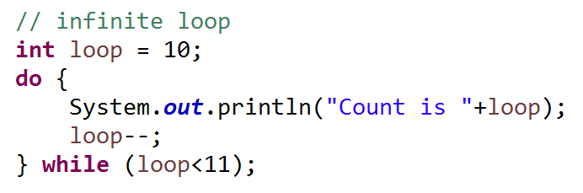
do .. while loop
10
9
8
7
6
5
4
3
2
1
0
Blast off !
An infinite loop – an example of logical programming error

Slide 9
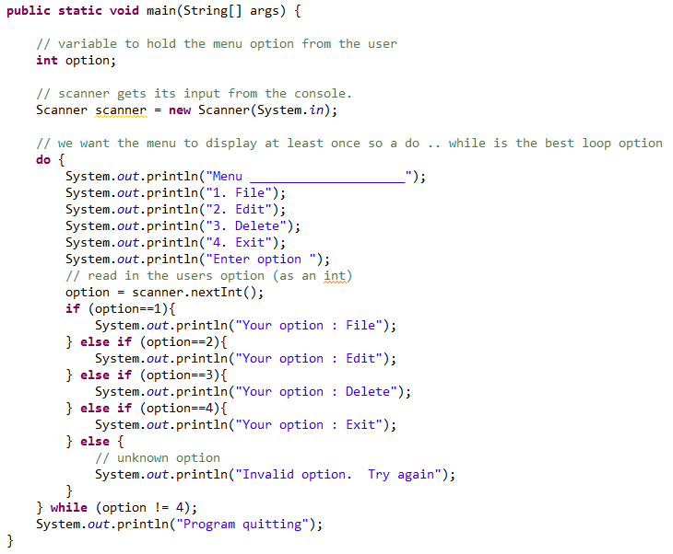
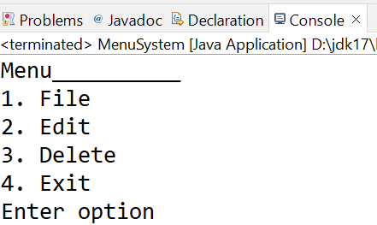
do .. while loop
do .. while example – code walk through

Slide 10
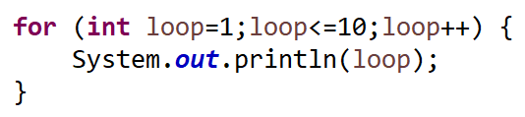
for loop
for (initialisation; termination; increment) { statement(s);
}
Specifies the counter-controlled-repetition details in a single line of code.
Probably the most commonly used loop statement in Java.
1
2
3
4
5
6
7
8
9
10

Slide 11
for loop
The termination condition is loop <= 10. (i.e. when this is false the loop terminates).
Initial Set up
The loop control variable is loop. The initial value of loop is 1.
The increment/ decrement expression is loop++
1. The termination condition is evaluated. As the loop value is initially 1 and this is less than or equal to 10 this evaluates to true and the loop body is executed. When it becomes false the loop is exited.
Iterations
3. Loop control variable is incremented. Then back to Step 1 and evaluate the termination condition based on the new Loop control variable value.
2. Loop body is executed

Slide 12
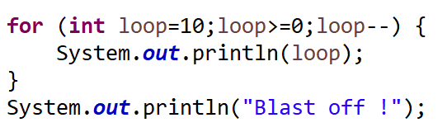

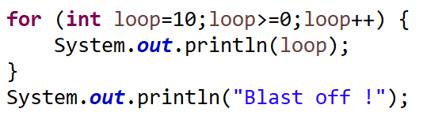
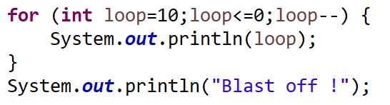
for loop
10
9
8
7
6
5
4
3
2
1
0
Blast off !
This one may go on for a while !
This one is not going too far

Slide 13
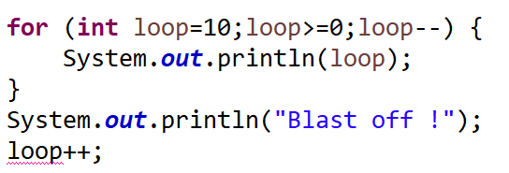

Scope
Local Scope variables declared inside a method or a block of code have local scope.
They are only accessible within the method or block in which they are declared.
These variables are created when the method or block is entered and destroyed when it exits.
They are not visible to other methods or blocks in your program
Variable scope refers to the region of your code where a particular variable is accessible and can be used. Variable scope determines the visibility and lifetime of a variable. Understanding variable scope is crucial for writing maintainable and bug-free code. There are three main levels of variable scope in Java 1. Local, 2. Instance Scope (more of this later in the course) and 3. Class (Static) Scope.
Scope of a for loop’s Control Variable
If the initialisation expression in the for header declares the control variable. The control variable can be used only in that for statement—it will not exist outside it.
This restricted use is known as the variable’s scope. (local).
Syntax error – variable is out of scope

Slide 14

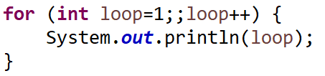
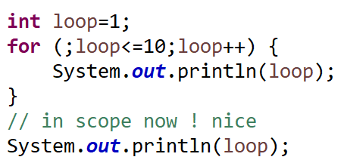
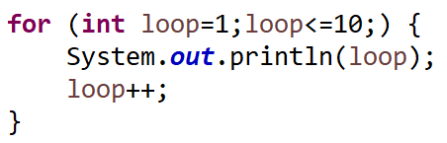
Optional expressions
All three expressions in a for header are optional.
If the Loop Continuation Condition is omitted, Java assumes that the loop-continuation condition is always true, thus creating an infinite loop.
You may omit the initialisation expression if the program initialises the control variable before the loop.
You may omit the increment expression if the program calculates the increment with statements in the loop’s body or if no increment is needed.

Slide 15

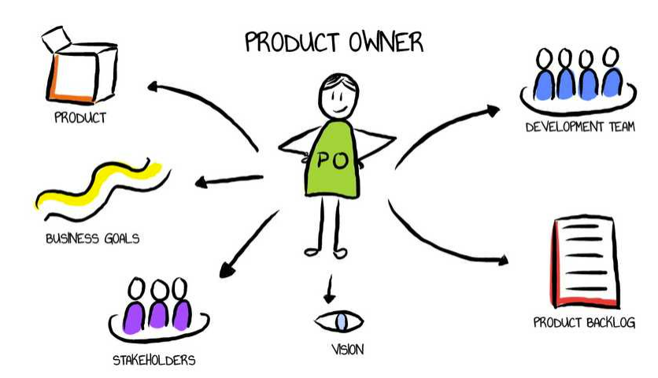
for loop exercise
User story : As a user, I want to be able to forecast my savings each year if I invest £1000 in a savings account yielding 5% interest each year. (Assuming that all the interest is left on deposit)
Hints :
The Product Owner (PO) has suggested the following ..
Use a for loop to calculate and display each year’s balance (loop needs to start at 1 and end at 10 (inclusive))
To calculate each year’s balance at %5 interest balance = balance * 1.05
e.g. Year 1 is £1000 (initial balance) *1.05 = £1050.00 (balance at end of year)
Printf will be useful to format to two decimal places.
The PO mentioned something about a constant..? (you might need to look that one up)
Expected output :
Year Amount(£)
1 1050.00
2 1102.50
3 1157.63
4 1215.51
etc
Notes:
Solution :
public class CompoundInterest {
// a constant! Using constants in your code helps improve readability,
// maintainability, and avoids magic numbers or hard-coded values. It also
// provides a centralised location to manage and change constant values if
// needed, making your code more robust and easier to maintain.
public static final double INTEREST_RATE = 0.05;
public static void main(String[] args) {
double balance;
balance = 1000;
System.out.println("Year \t\tAmount(£)");
for (int year = 1; year <= 10; year++) {
balance = balance * (1 + INTEREST_RATE);
System.out.printf("%d \t\t%.2f\n", year, balance);
}
}

Slide 16
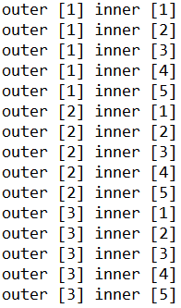
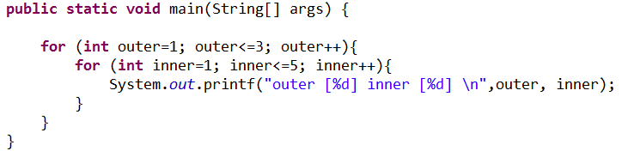
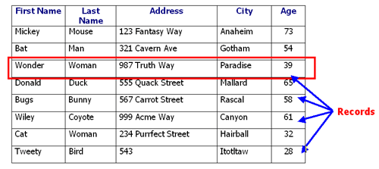
Nested for loops
A loop within a loop. The outer loop iterates once and then the inner loop iterates 5 times.
Then the outer iterates again and the inner 5 times again (every time the inner is run to completion it’s counter values are reset)
Notes:
you can nest one or more for loops inside another for loop or any other type of loop. This is called nested loops. Nested loops are useful when you need to perform repeated operations within another loop. They allow you to create complex patterns, iterate through multi-dimensional data structures, and solve problems that involve nested structures.

Slide 17

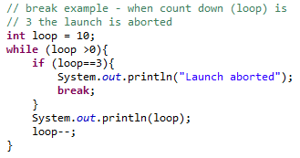
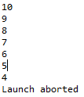
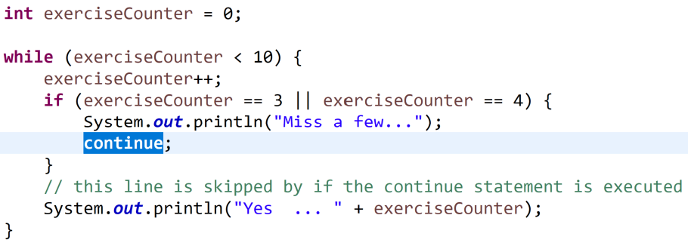
break and continue
the break and continue statements are control flow statements that allow you to alter the flow of execution within loop and switch statements. They provide a way to exit a loop prematurely or skip the remaining code within a loop iteration, respectively
Yes ... 1
Yes ... 2
Miss a few...
Miss a few...
Yes ... 5
Yes ... 6
Yes ... 7
Yes ... 8
Yes ... 9
Yes ... 10

Slide 18
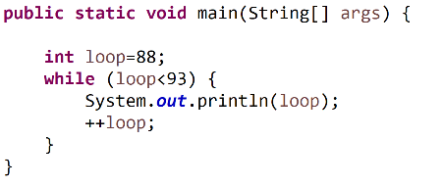
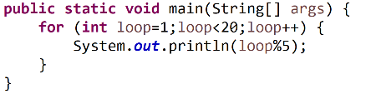
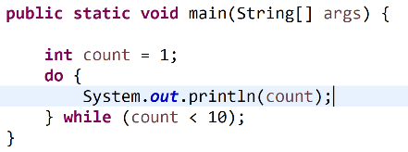
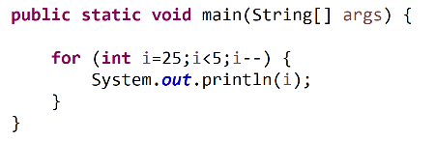
Dry run – what’s the output ?
Notes:
In the context of coding and software development, a "dry run" refers to the process of mentally or manually simulating the execution of a piece of code or an algorithm without actually running it on a computer. It's a way to analyse and understand how a program works or how specific code logic operates before executing it.
Here's how a dry run typically works:
Code Inspection: You carefully read through the code or algorithm you want to analyse, paying close attention to each line, variable, condition, and loop.
Step-by-Step Execution: Mentally or on paper, you simulate the execution of the code or algorithm step by step, tracking the changes in variables and the flow of control.
Data Values: You keep track of the values of variables at each step to ensure they are updated correctly and in accordance with the intended logic.
Conditional Branching: You evaluate conditions and branching statements (e.g., if statements, loops) to determine the path the program will take based on the input or data you're simulating.
Output: You note the expected output or the state of the program at the end of the dry run to verify that it aligns with your expectations.
Dry runs are particularly useful for the following purposes:
Understanding Code: They help developers understand how a piece of code functions, especially when working with complex algorithms or logic.
Identifying Bugs: Dry runs can reveal logical errors or bugs in code by allowing you to detect unexpected behaviour or incorrect variable values.
Algorithm Design: When designing algorithms, dry runs can help you refine your approach and identify potential issues before implementing the code.
Debugging: During the debugging process, dry runs can assist in tracing the flow of execution and pinpointing the source of errors.
Dry runs are often performed on paper or using a whiteboard, where developers can write down variable values and visualize the code's execution. It's a valuable practice for both beginners and experienced programmers to gain a deeper understanding of code and troubleshoot issues effectively before running the code on a computer, saving time and effort in the debugging process.

Slide 19

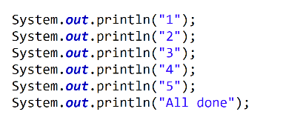
Full marks ..?
Write a code snippet that will output the numbers 1 to 5 (inclusive) on separate lines and finish with the text “All done” printed to screen

Slide 20

You :
“ In Java, loops are control structures that allow you to execute a block of code repeatedly as long as a certain condition is true. Loops are essential for automating repetitive tasks and iterating over data structures like arrays or collections. There are three main types of loops: for, while, and do-while
The choice of which loop to use depends on the specific requirements of your program and the nature of the looping task. The for loop has three parts: initialisation, condition, and iteration, making it well-suited for situations where you need to control loop variables precisely. Use a for loop when you know in advance how many times you want to repeat a block of code. It's particularly useful for iterating over arrays, collections, or sequences with a known length.
The while loop checks the condition before entering the loop, which means it might not execute at all if the condition is initially false. Use a while loop when you want to repeatedly execute a block of code as long as a certain condition remains true. It's suitable for situations where you don't know in advance how many iterations will be needed.
The do-while loop checks the condition after executing the loop body, guaranteeing that the loop body is executed at least once. Use a do-while loop when you want to ensure that a block of code is executed at least once, regardless of the condition. It's useful when you want to validate user input or perform an initial iteration before checking a condition. Really good for menus. ”
Interviewer: “Tell me about Java’s loops and when you would use each of them?”

